Slide 1
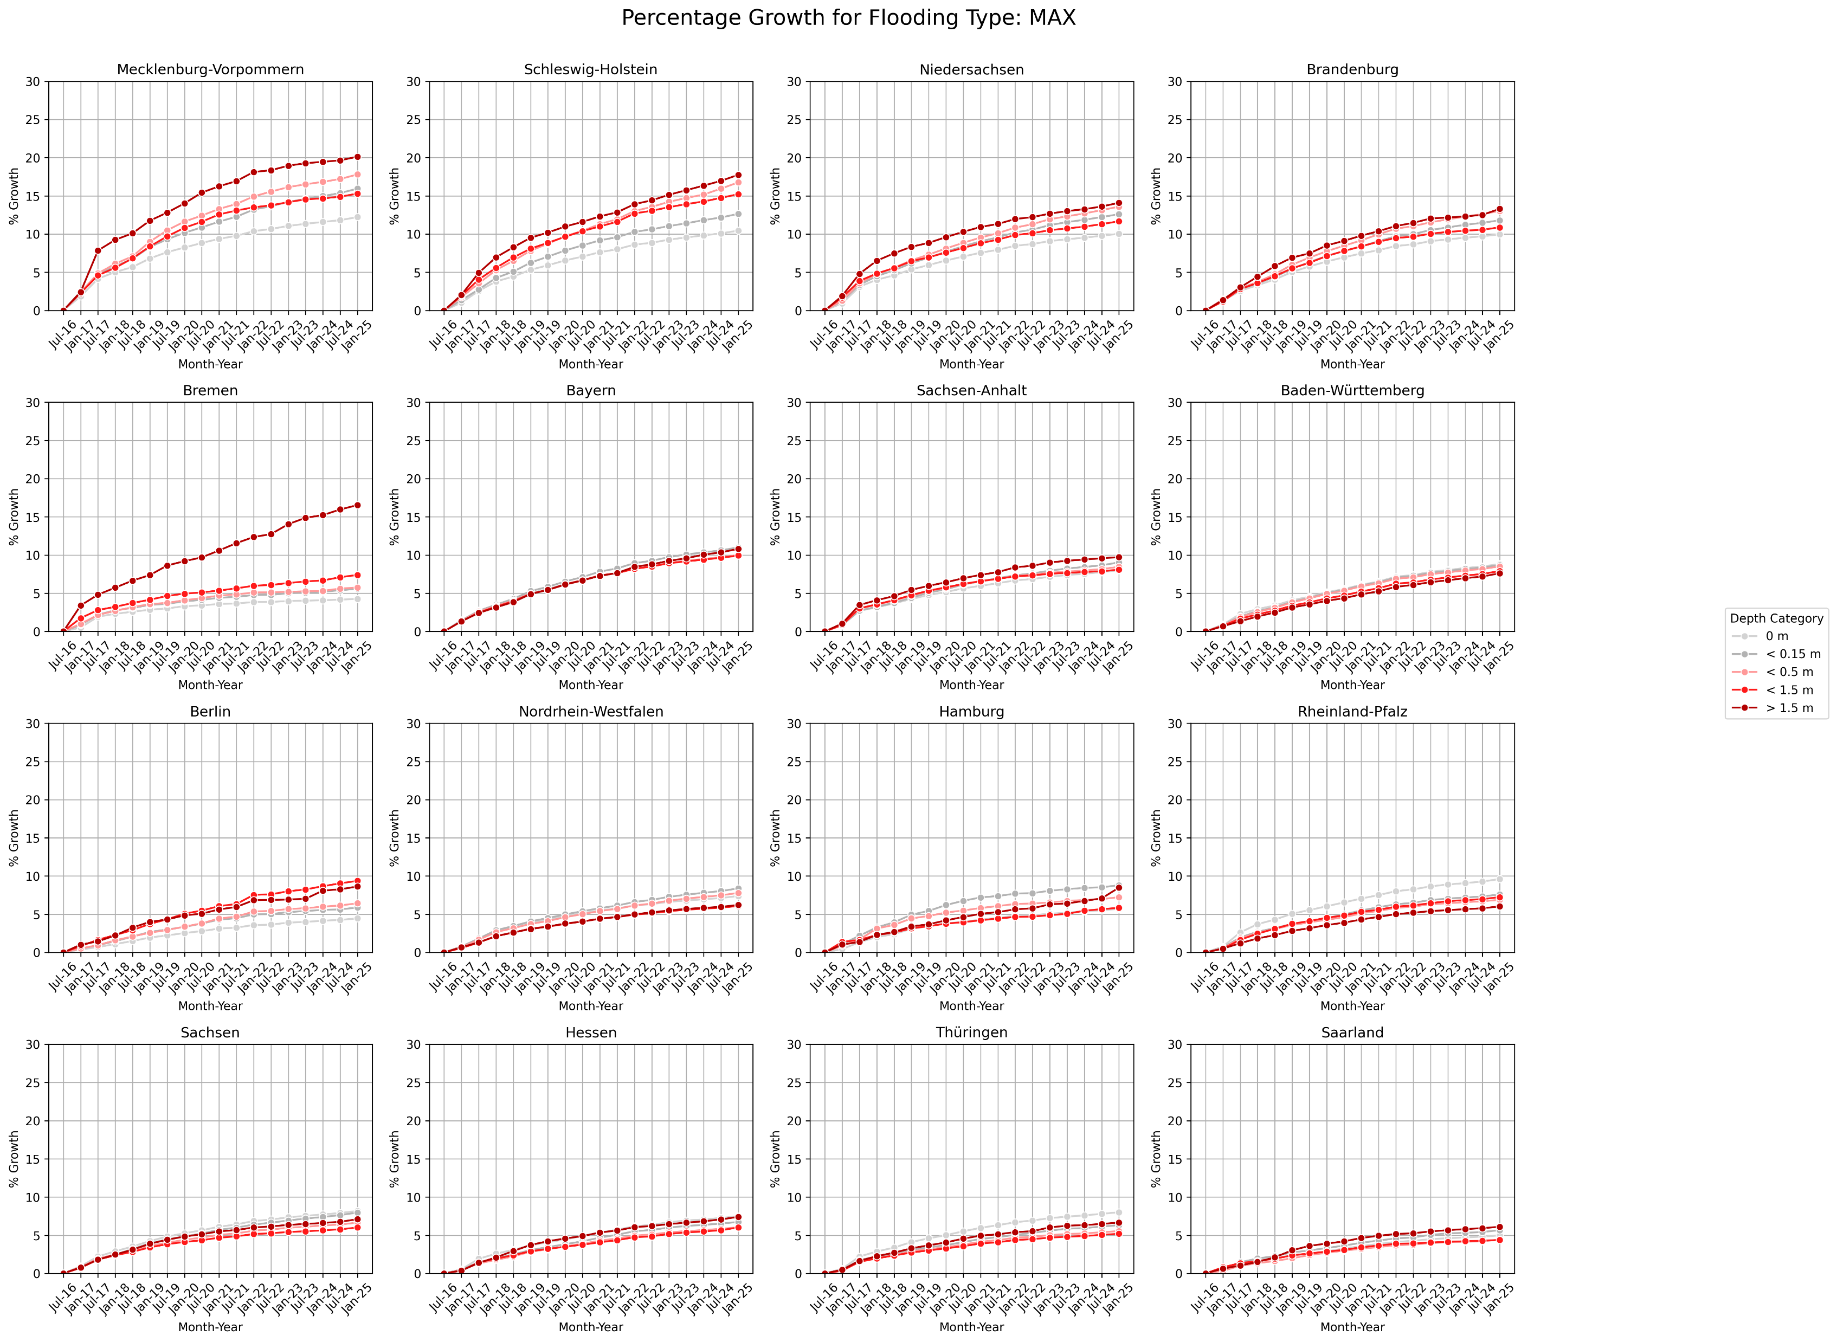

Slide 2
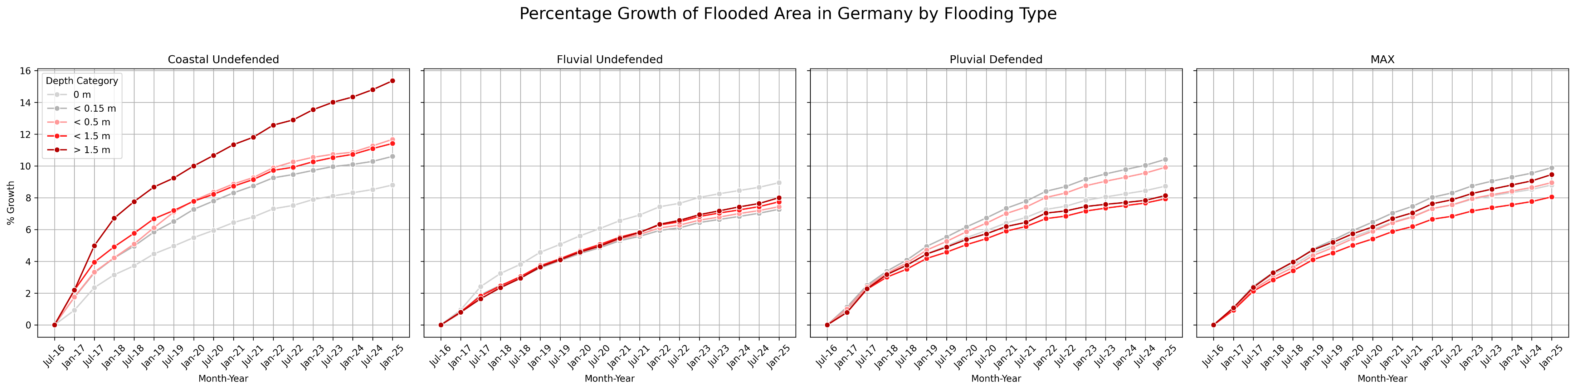

Slide 3
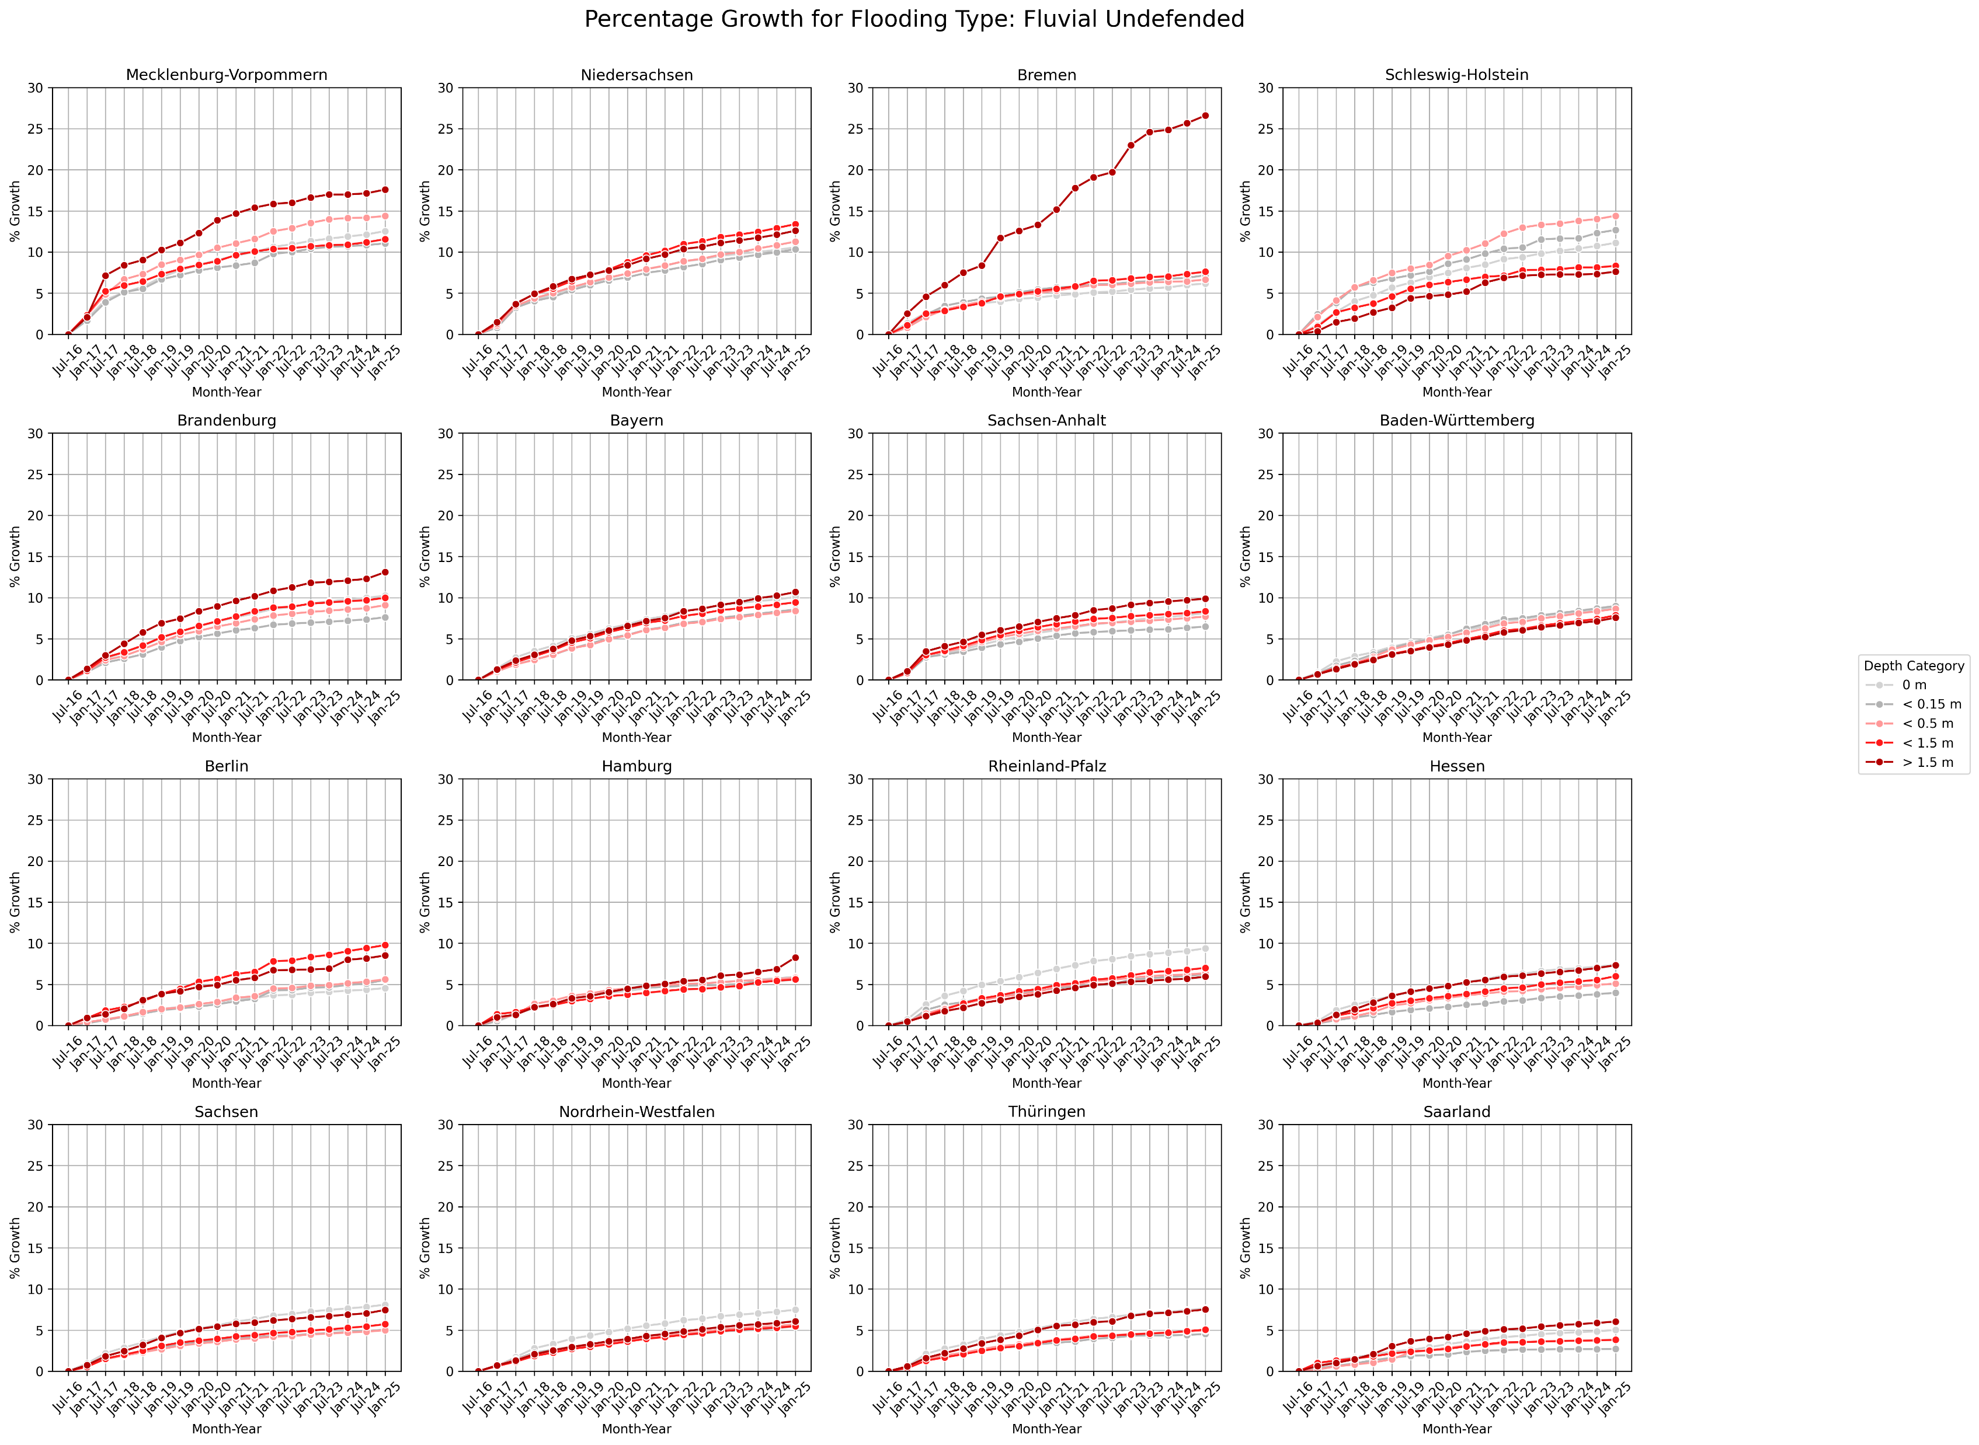

Slide 4
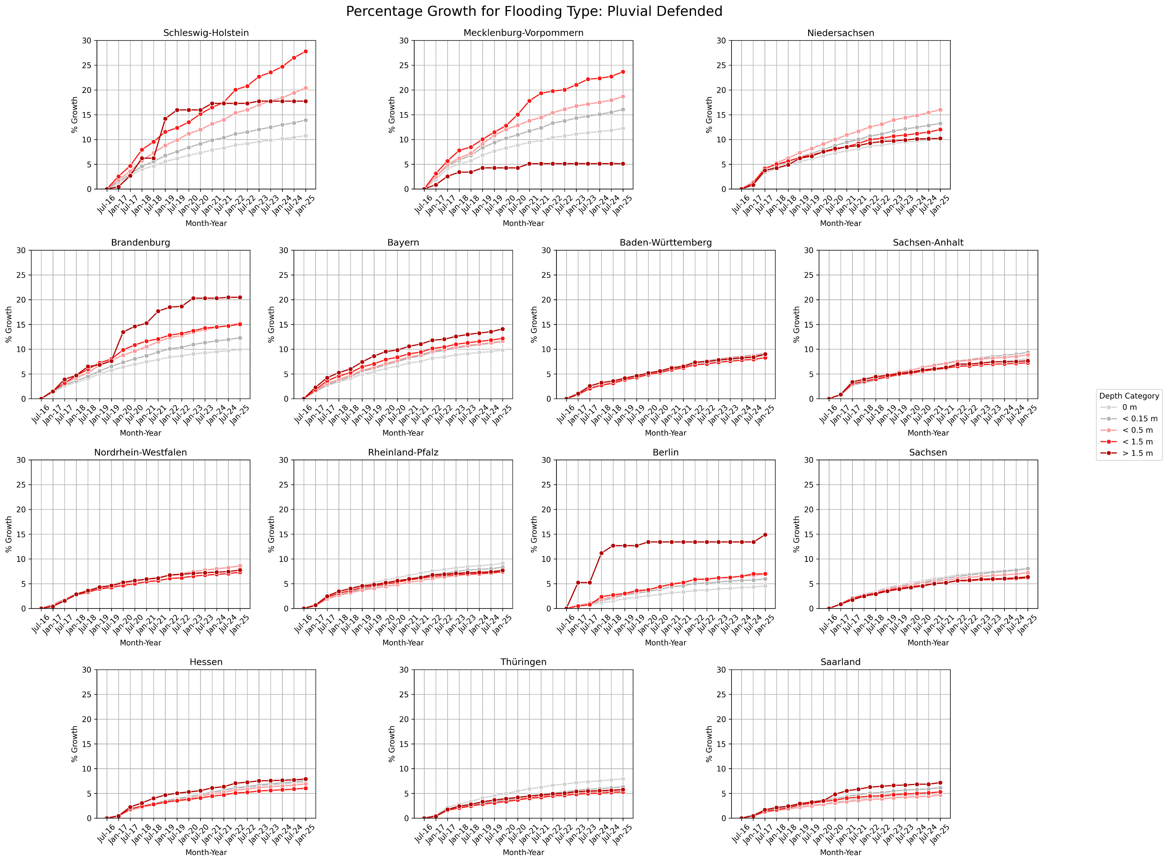

Slide 5
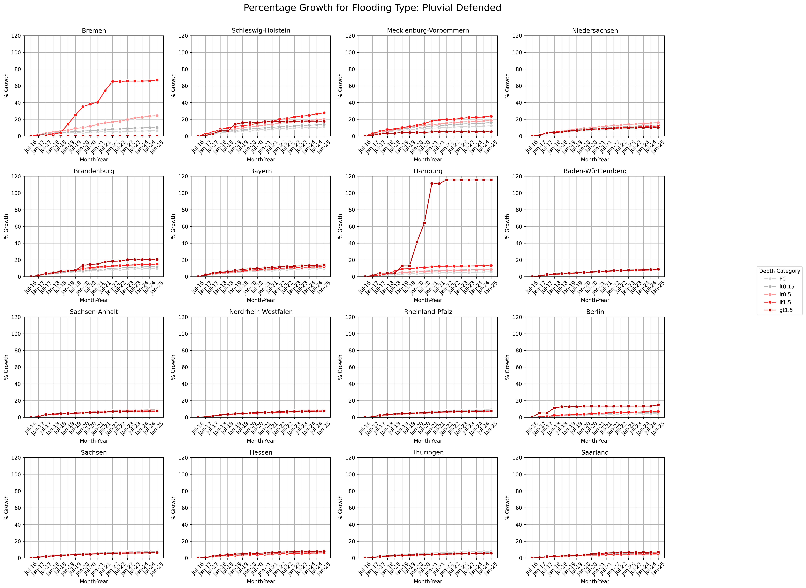
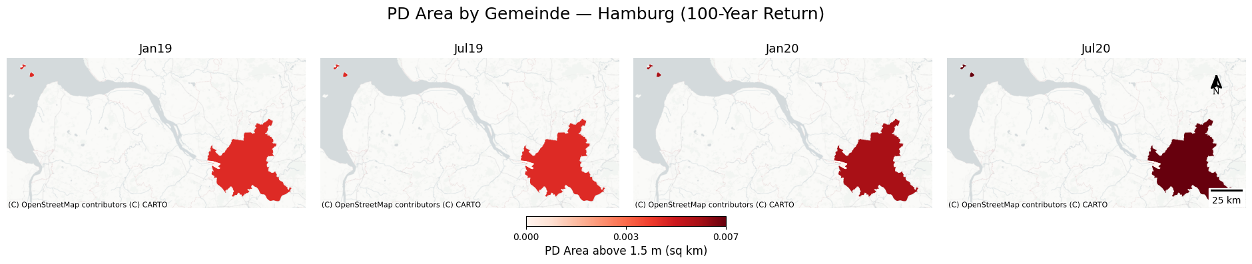
Hamburg is not included in the percentage growth of settlement area under the pluvial flooding scenario, as only a small area experienced a substantial percentage increase in flooding depth exceeding 1.5 meters.

Slide 6
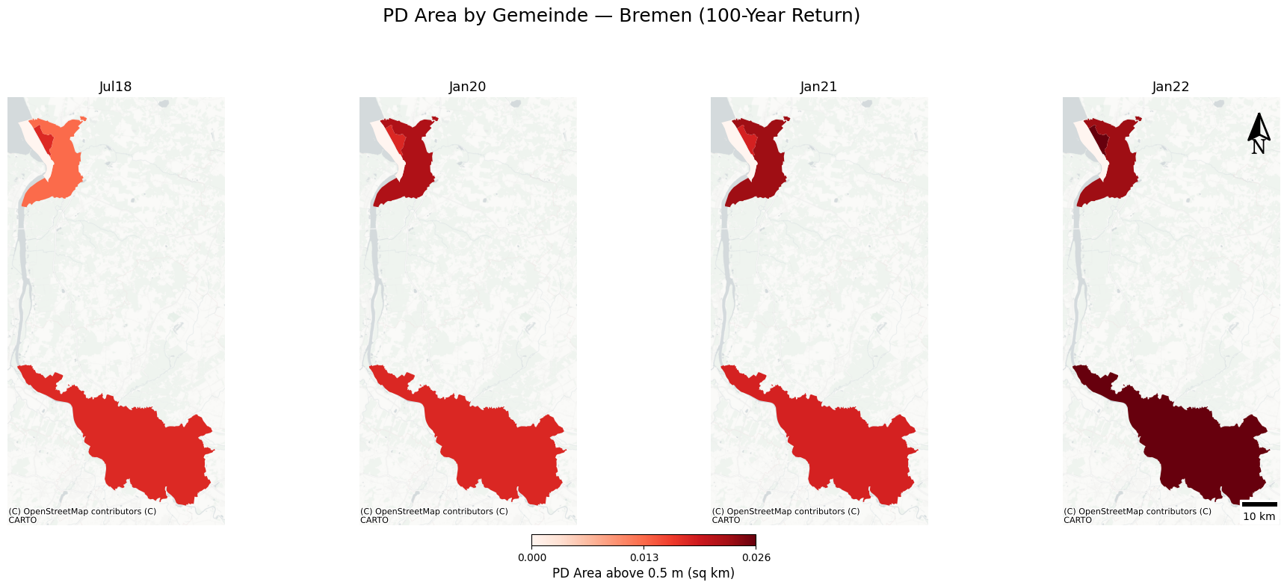
Bremen is not included for a similar reason; only a small area experienced a substantial percentage increase in flooding depth exceeding 0.5 meters.

Slide 7
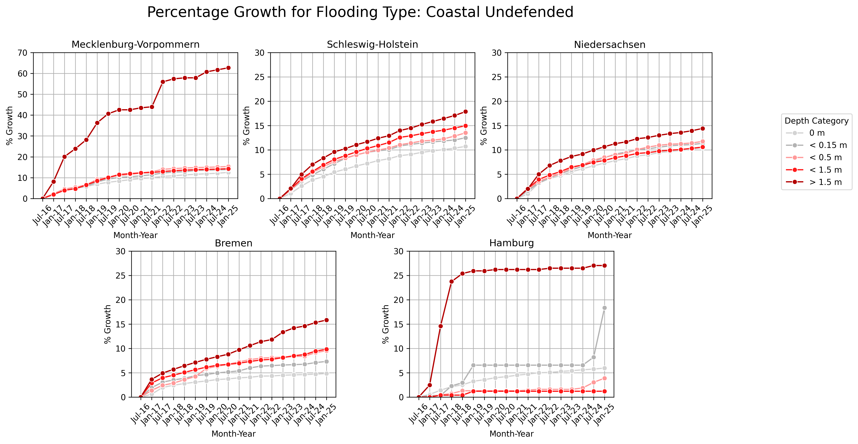

Slide 8
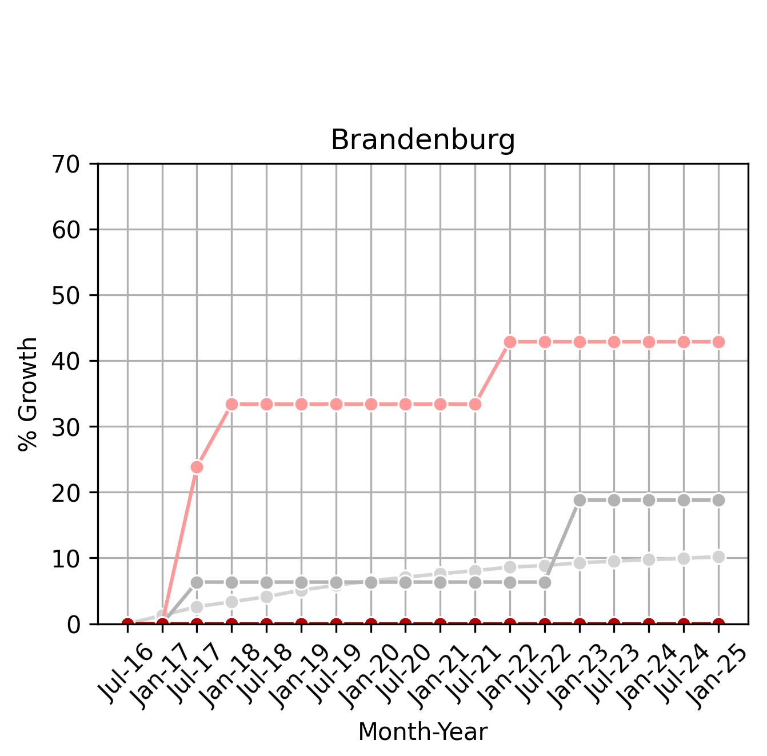
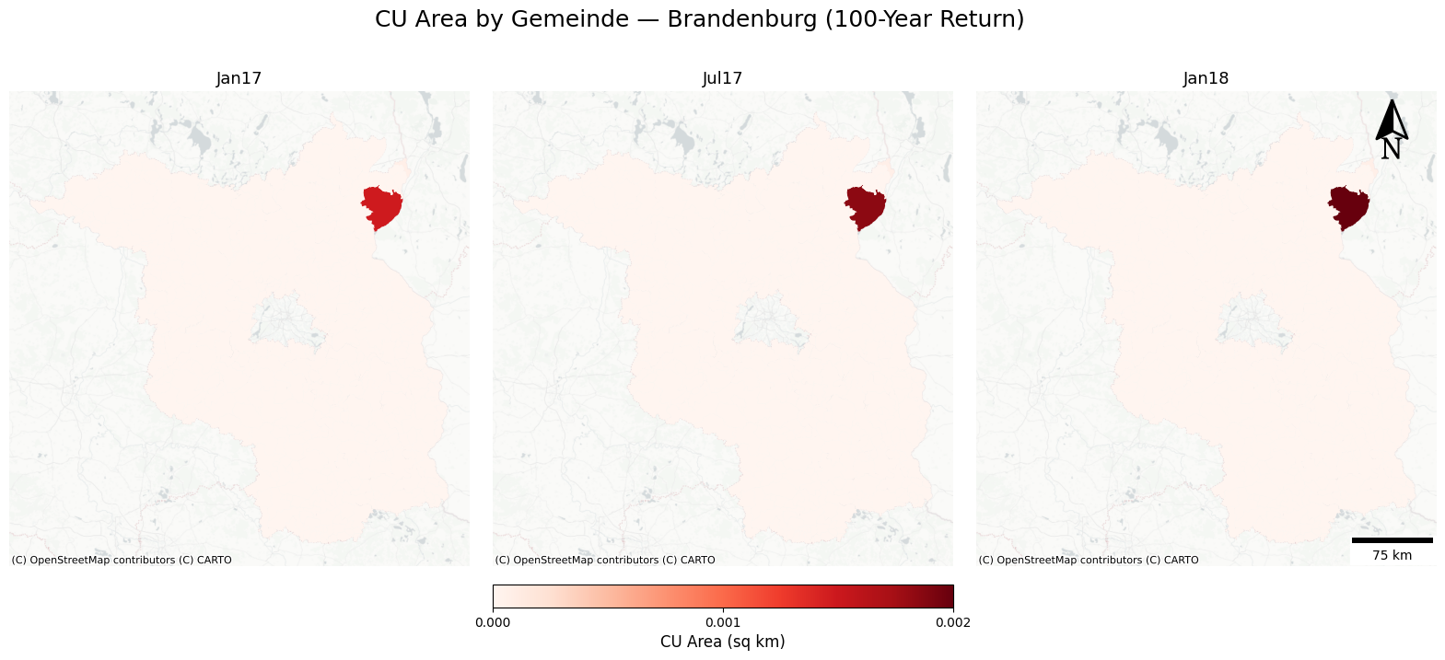
Same for Brandenburg under the coastal flooding scenario.
(flooding depth between 0.15 m and 0.5 m)

Slide 9
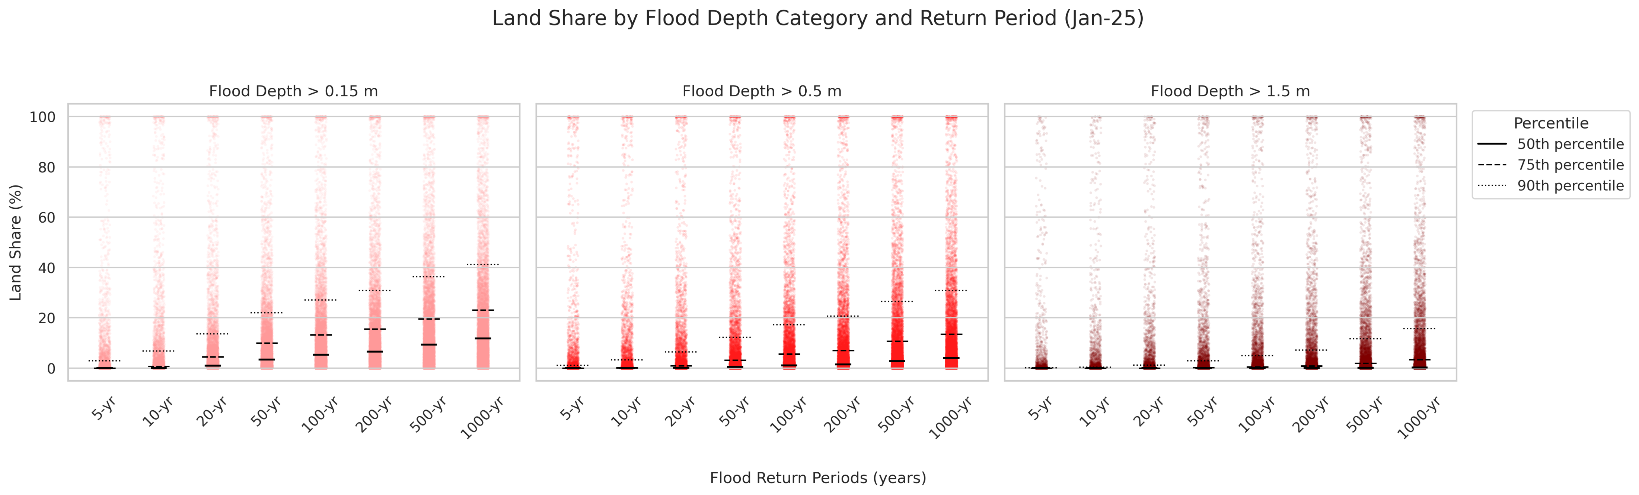

Slide 10
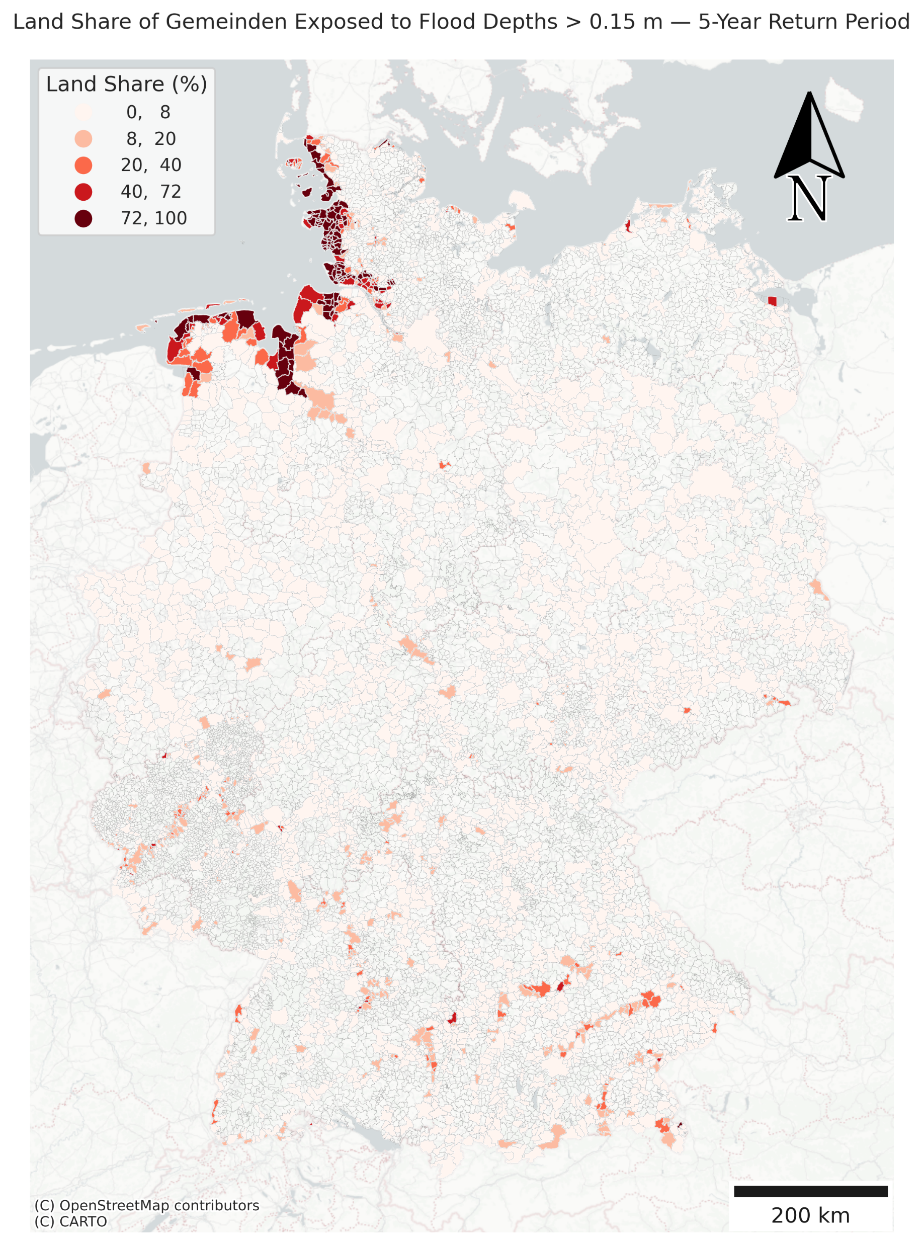
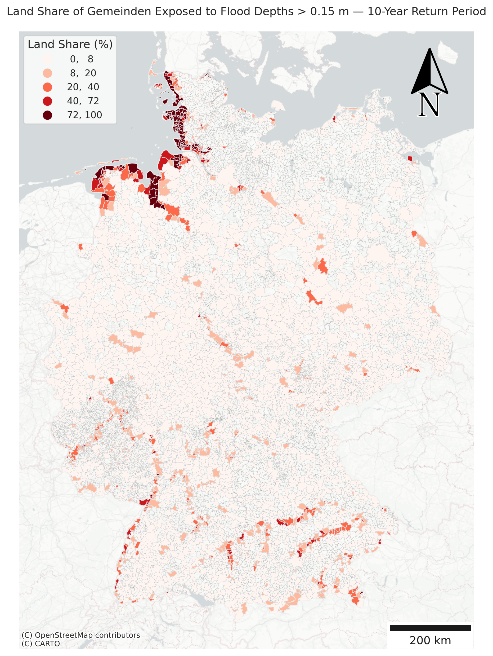
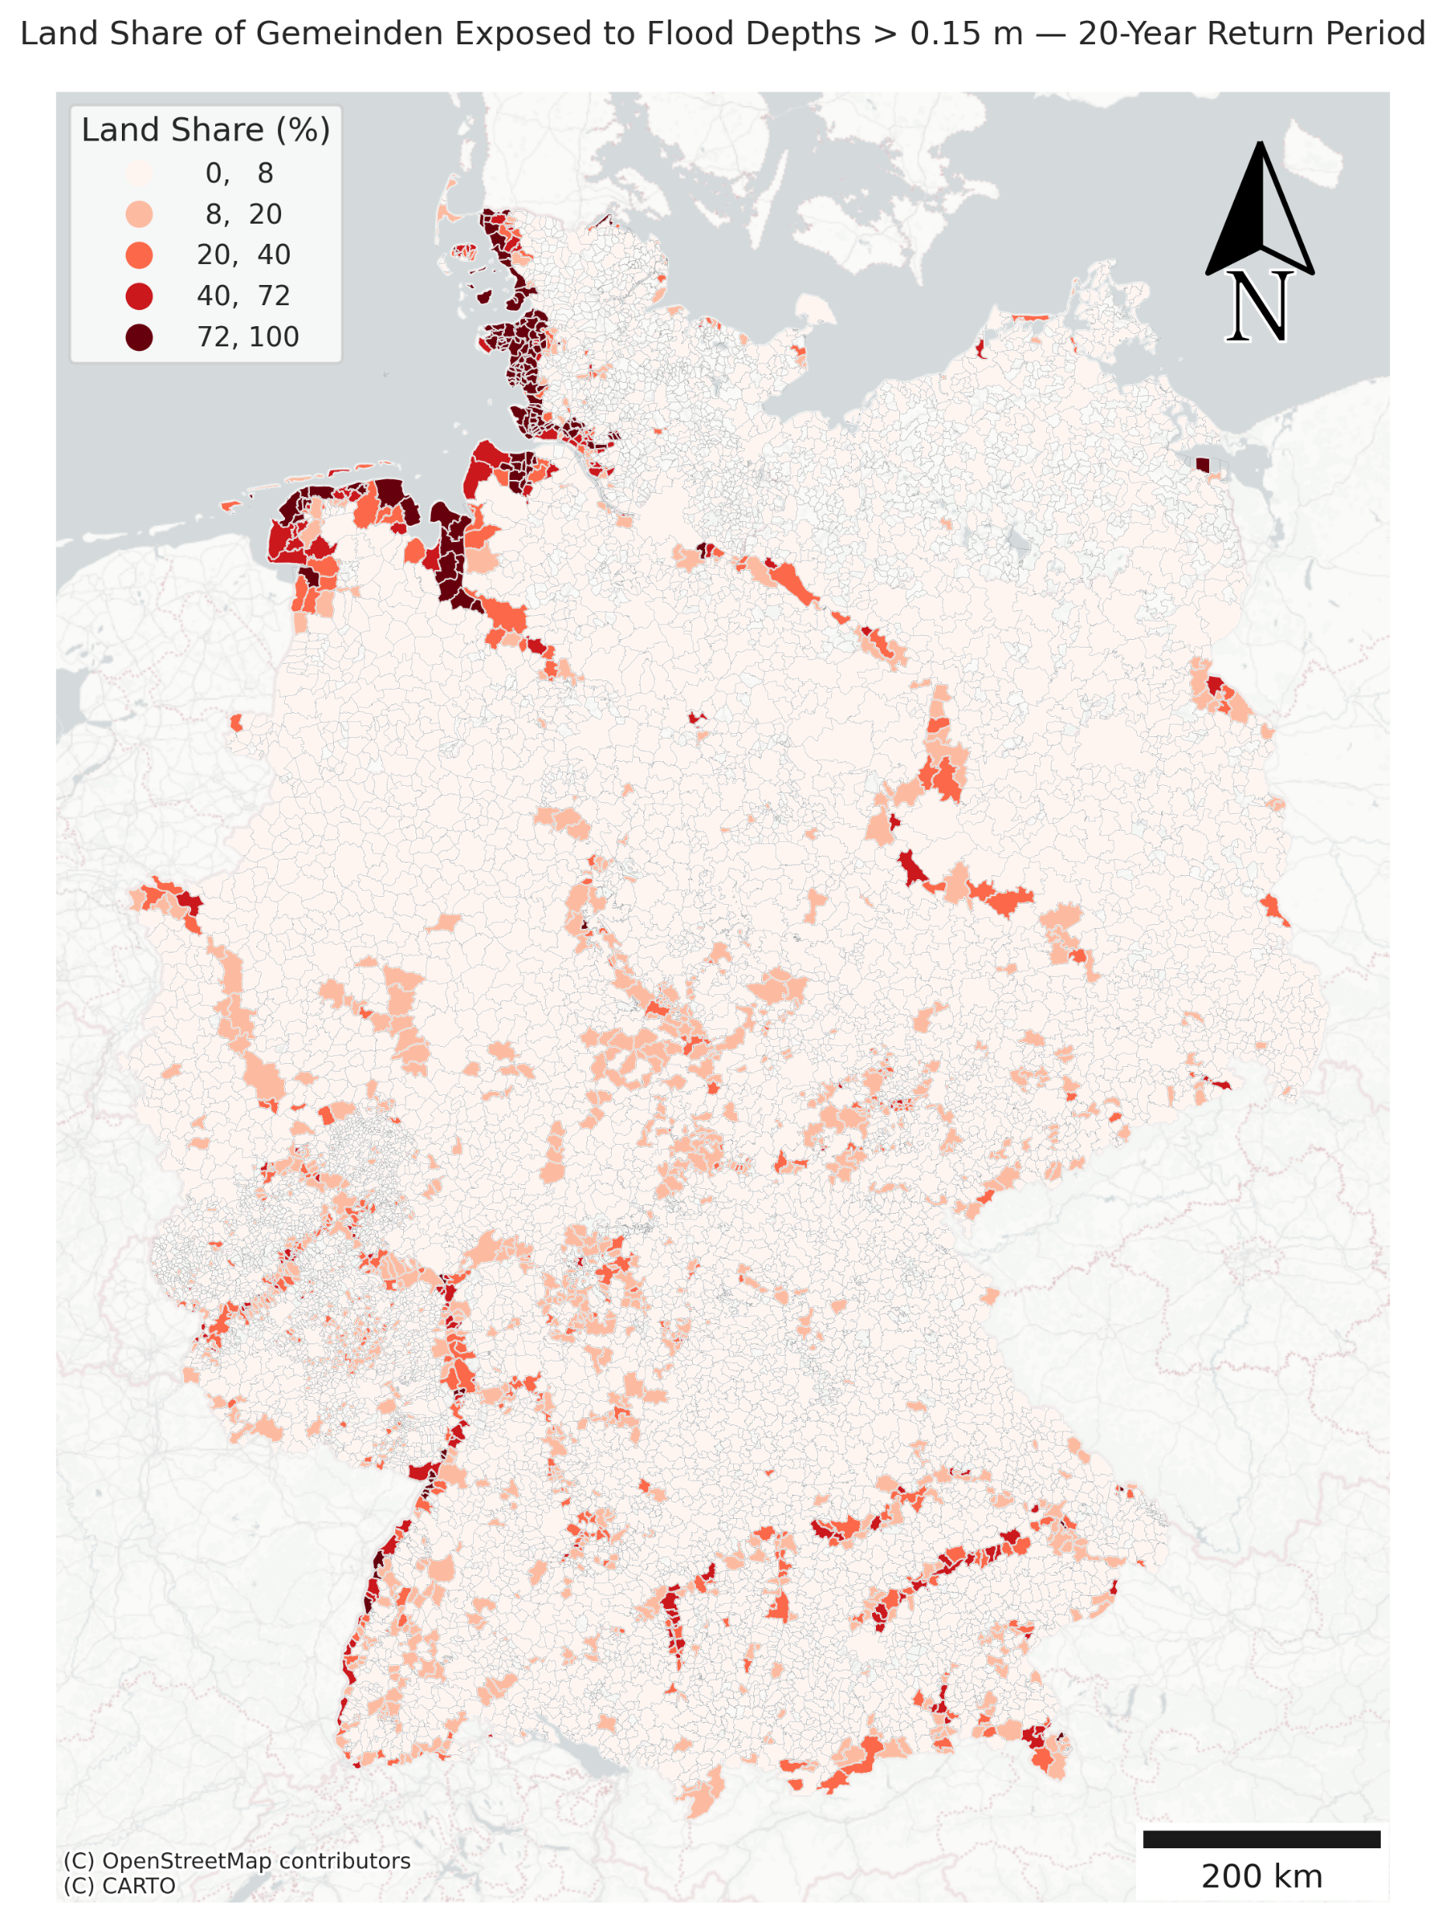
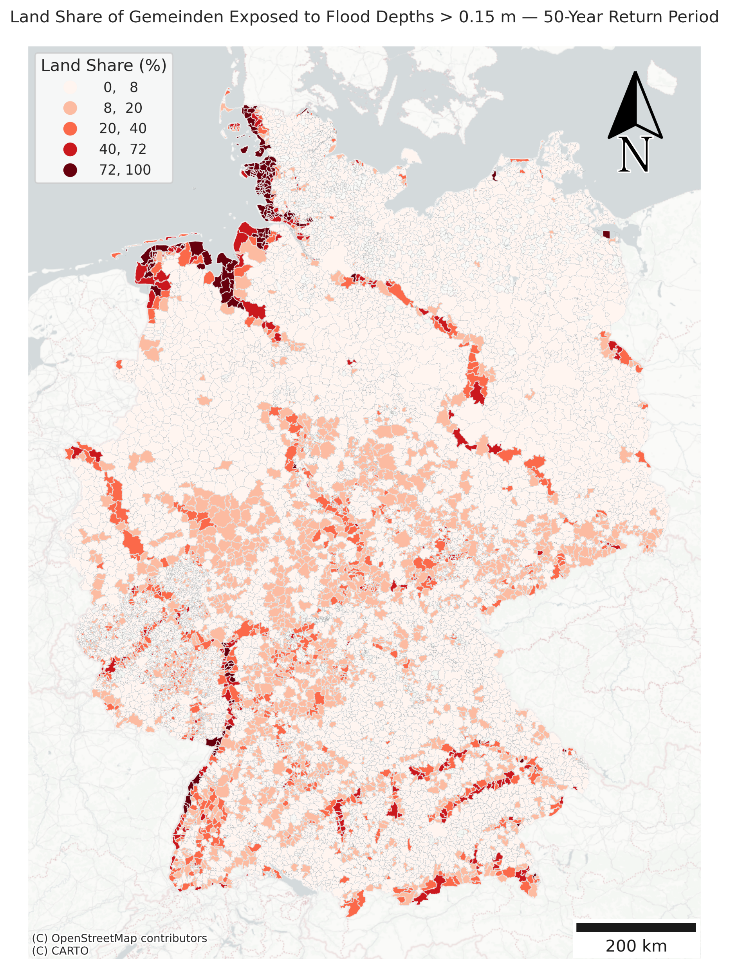

Slide 11
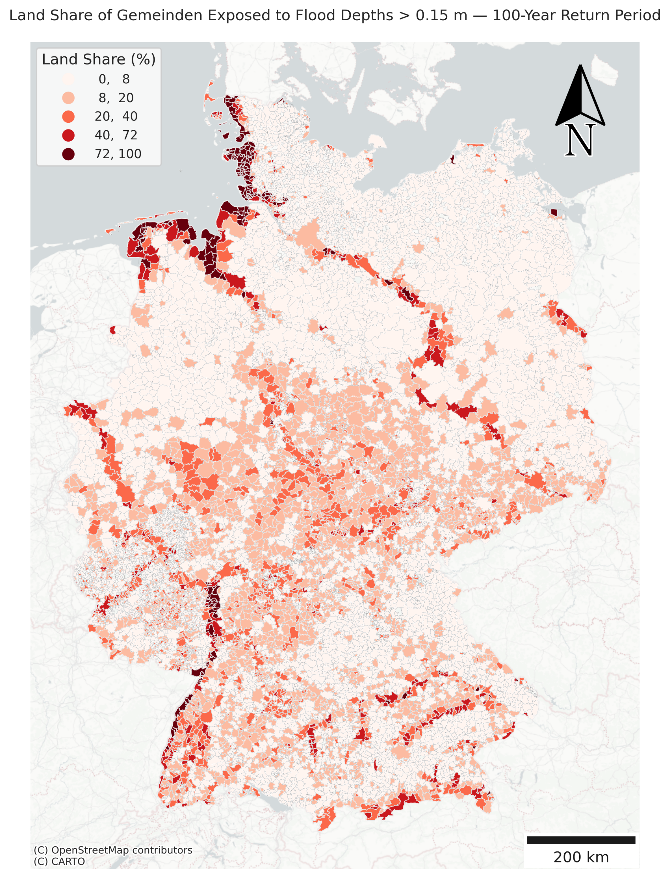
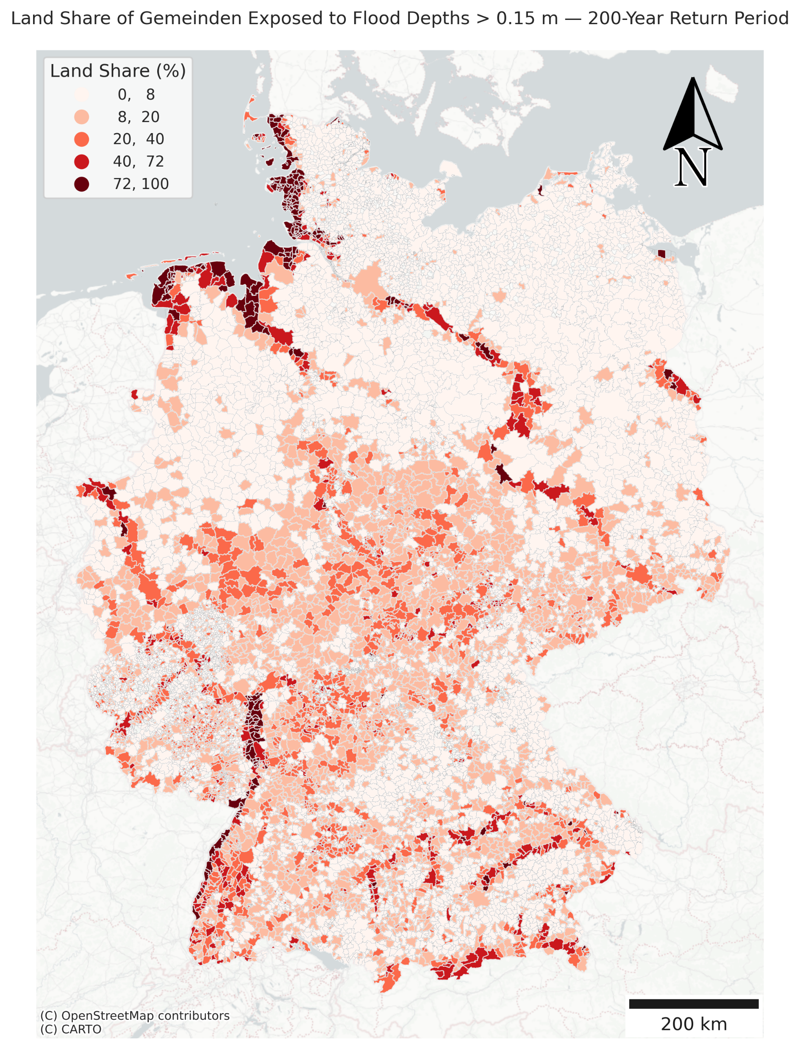
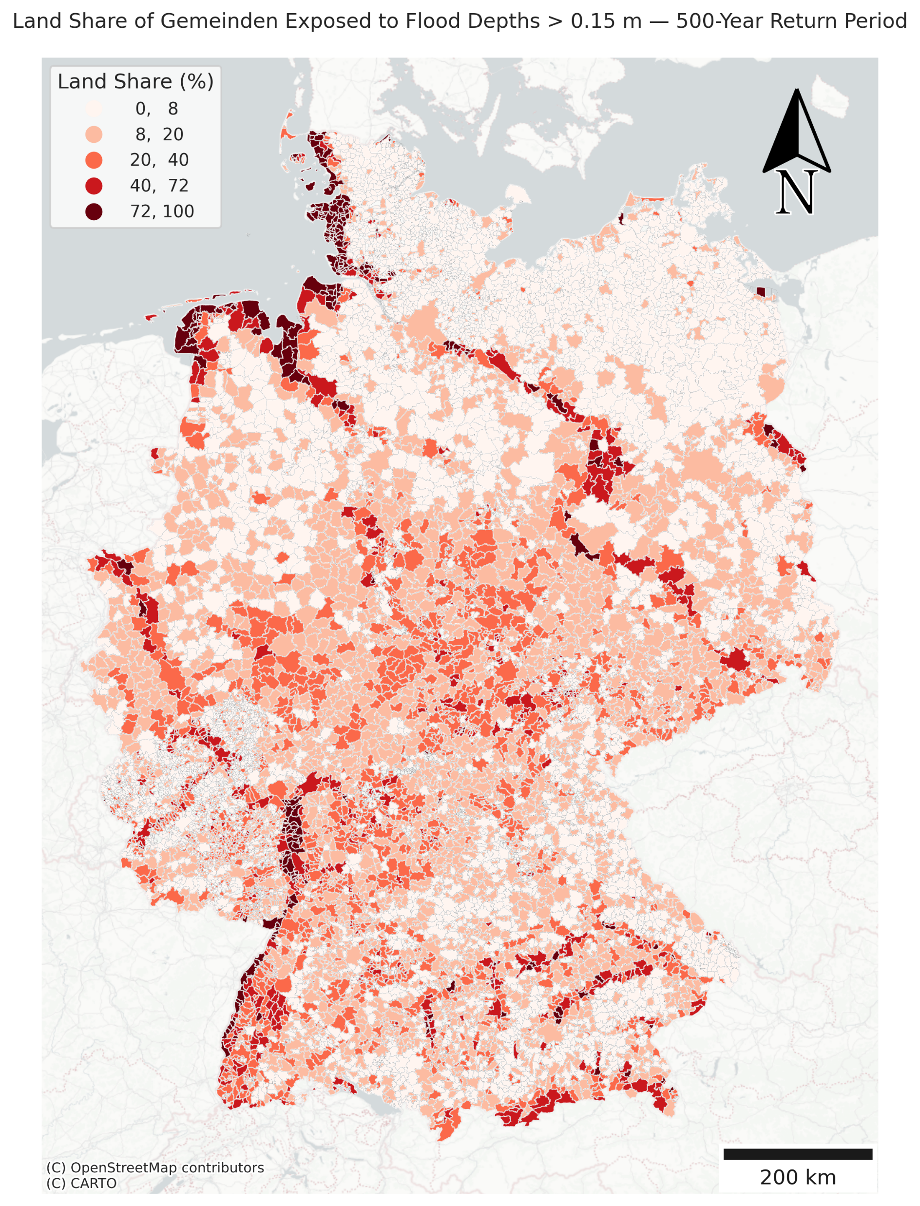
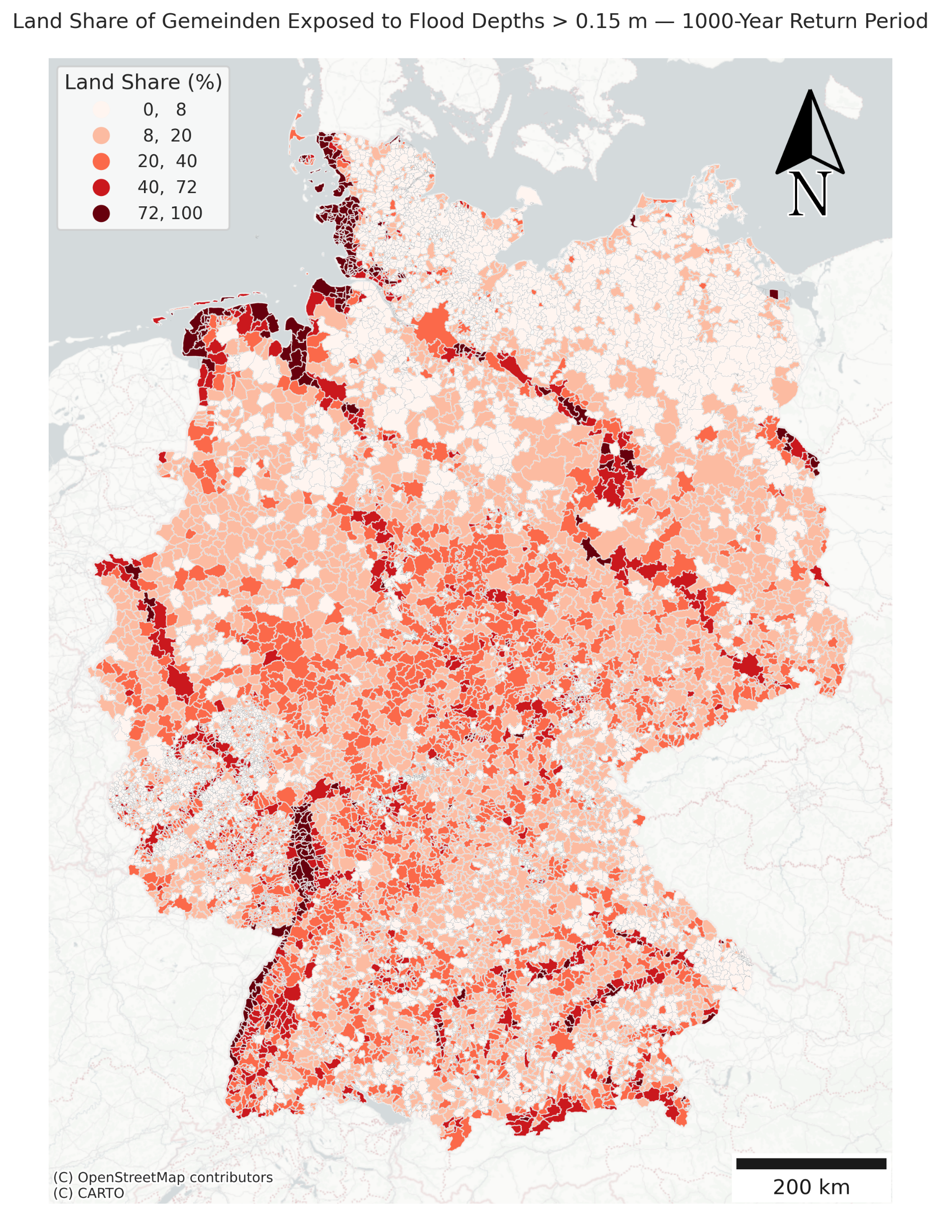

Slide 12
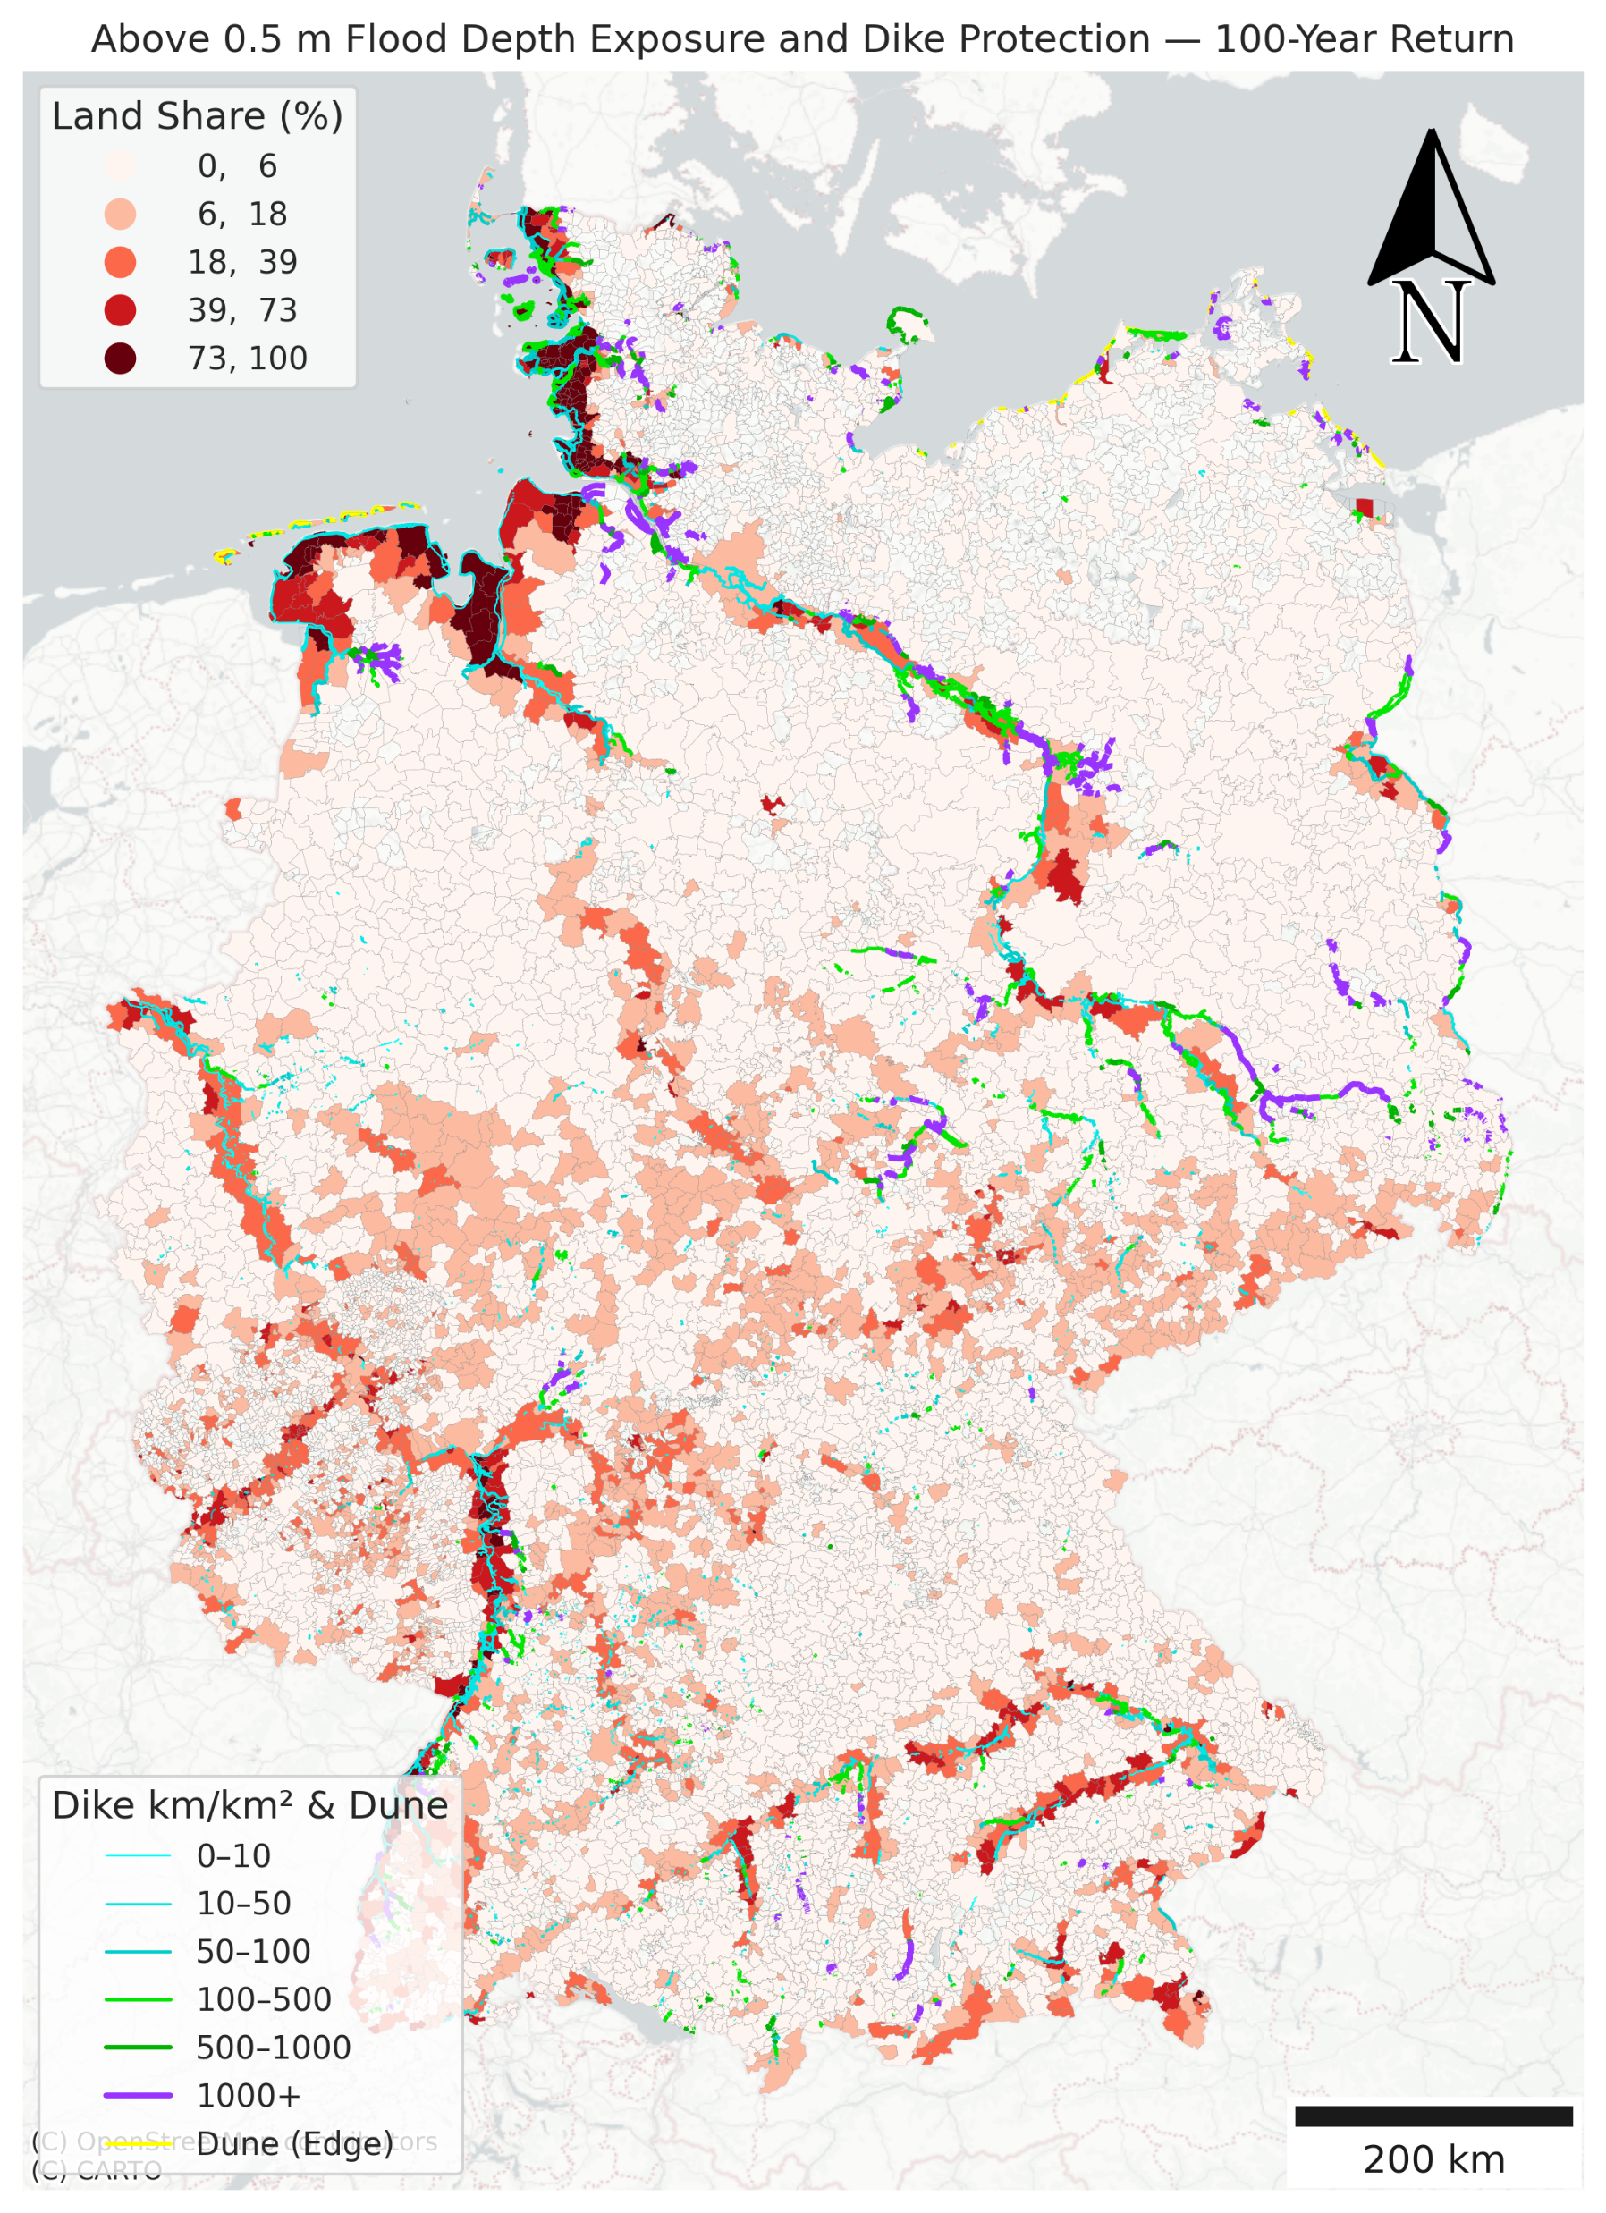
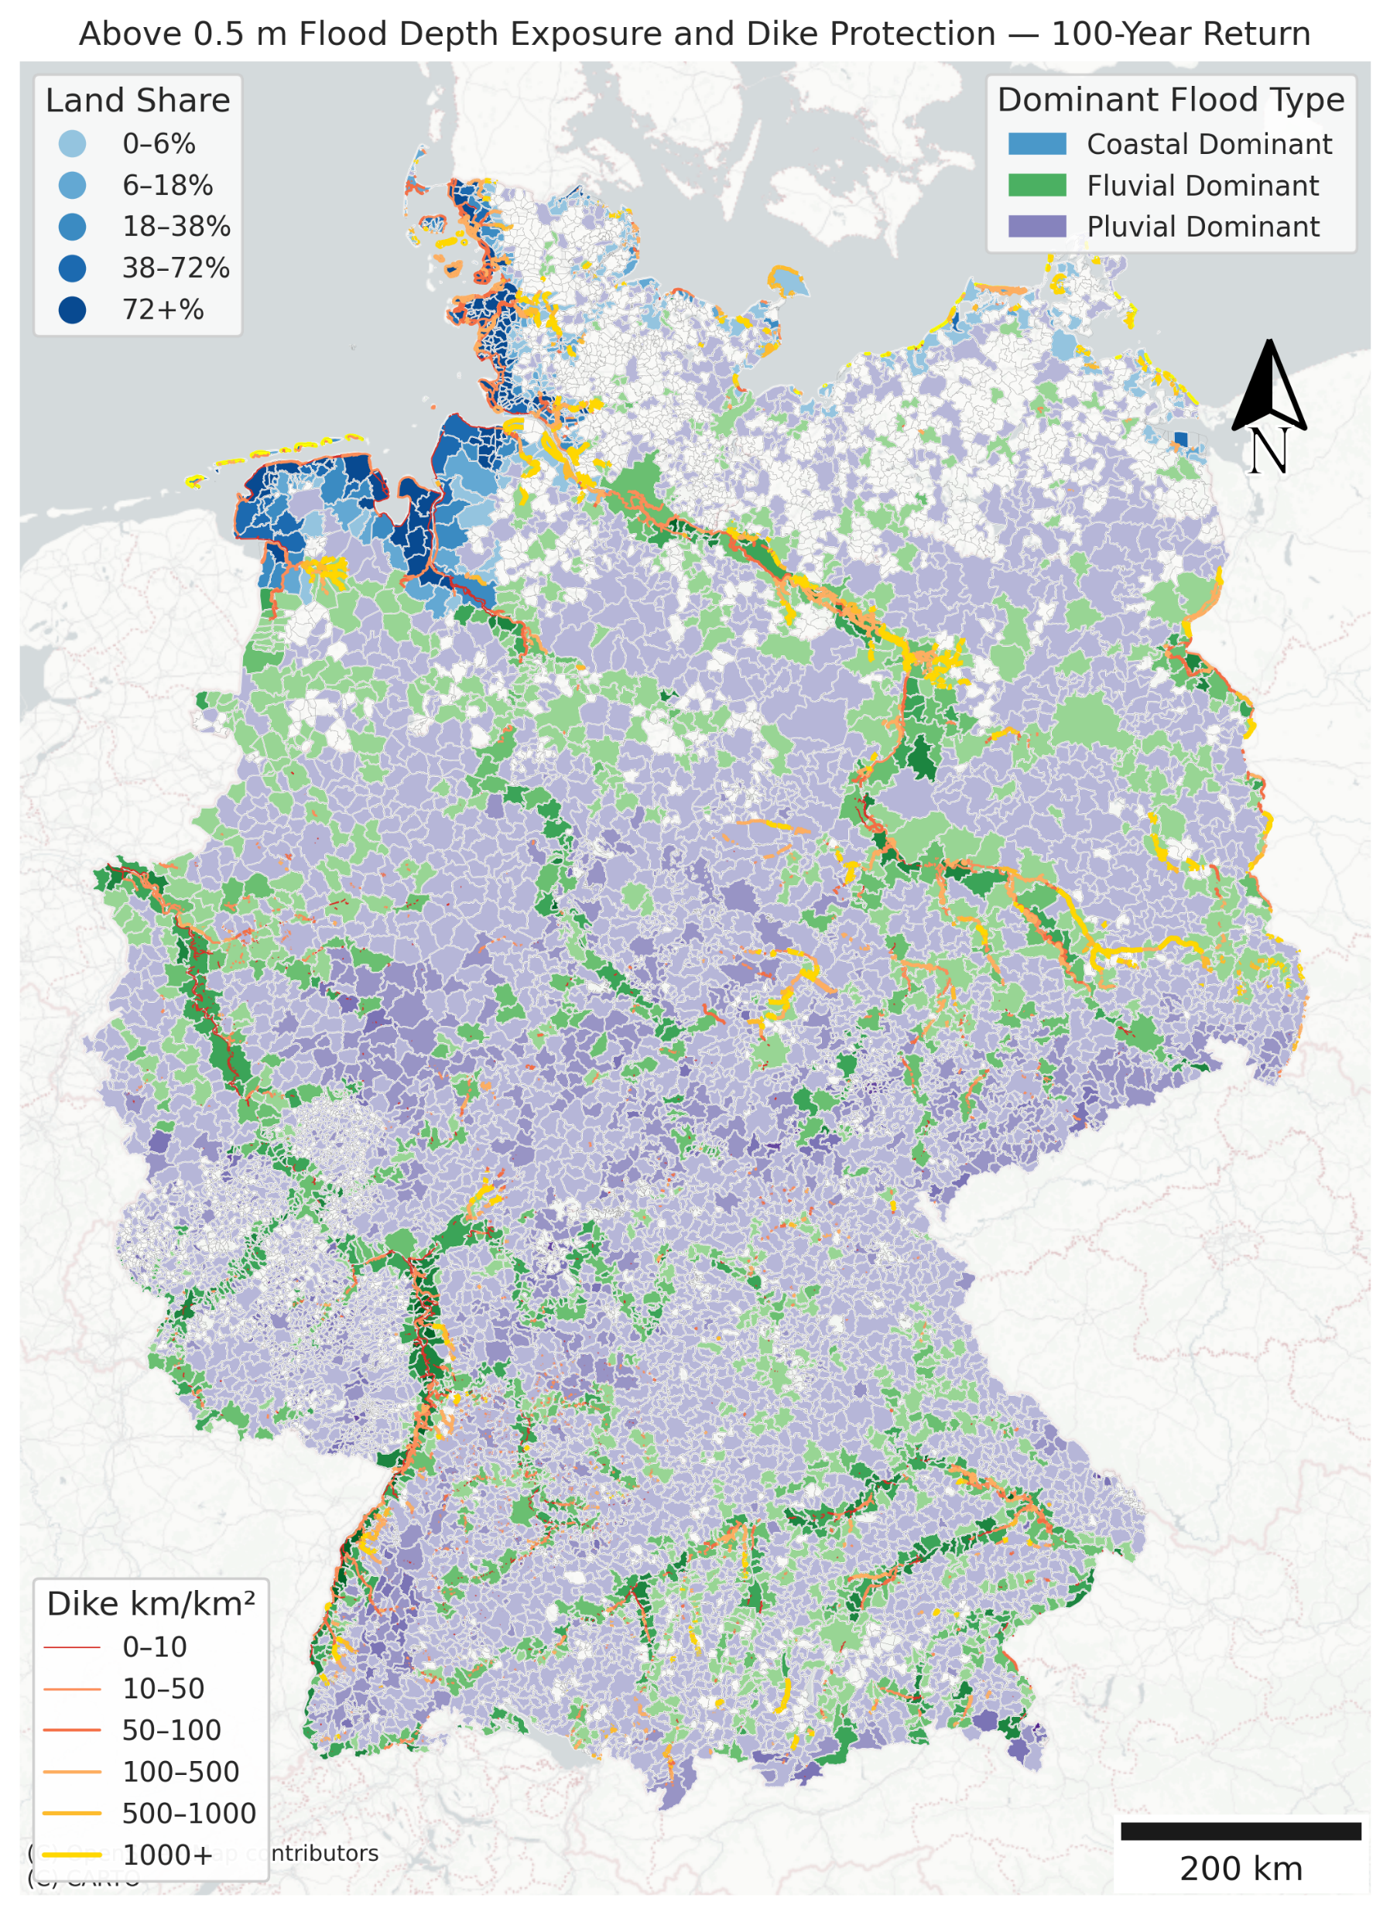
Total length of currently constructed dike = 13237.16 km

Slide 13
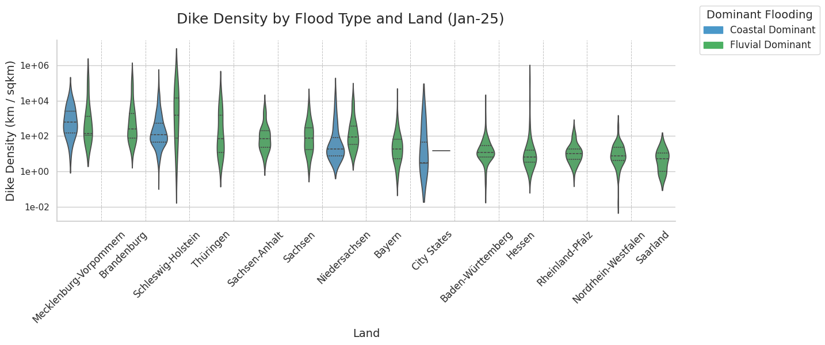
City State: Bremen, Berlin, Hamburg

Slide 14
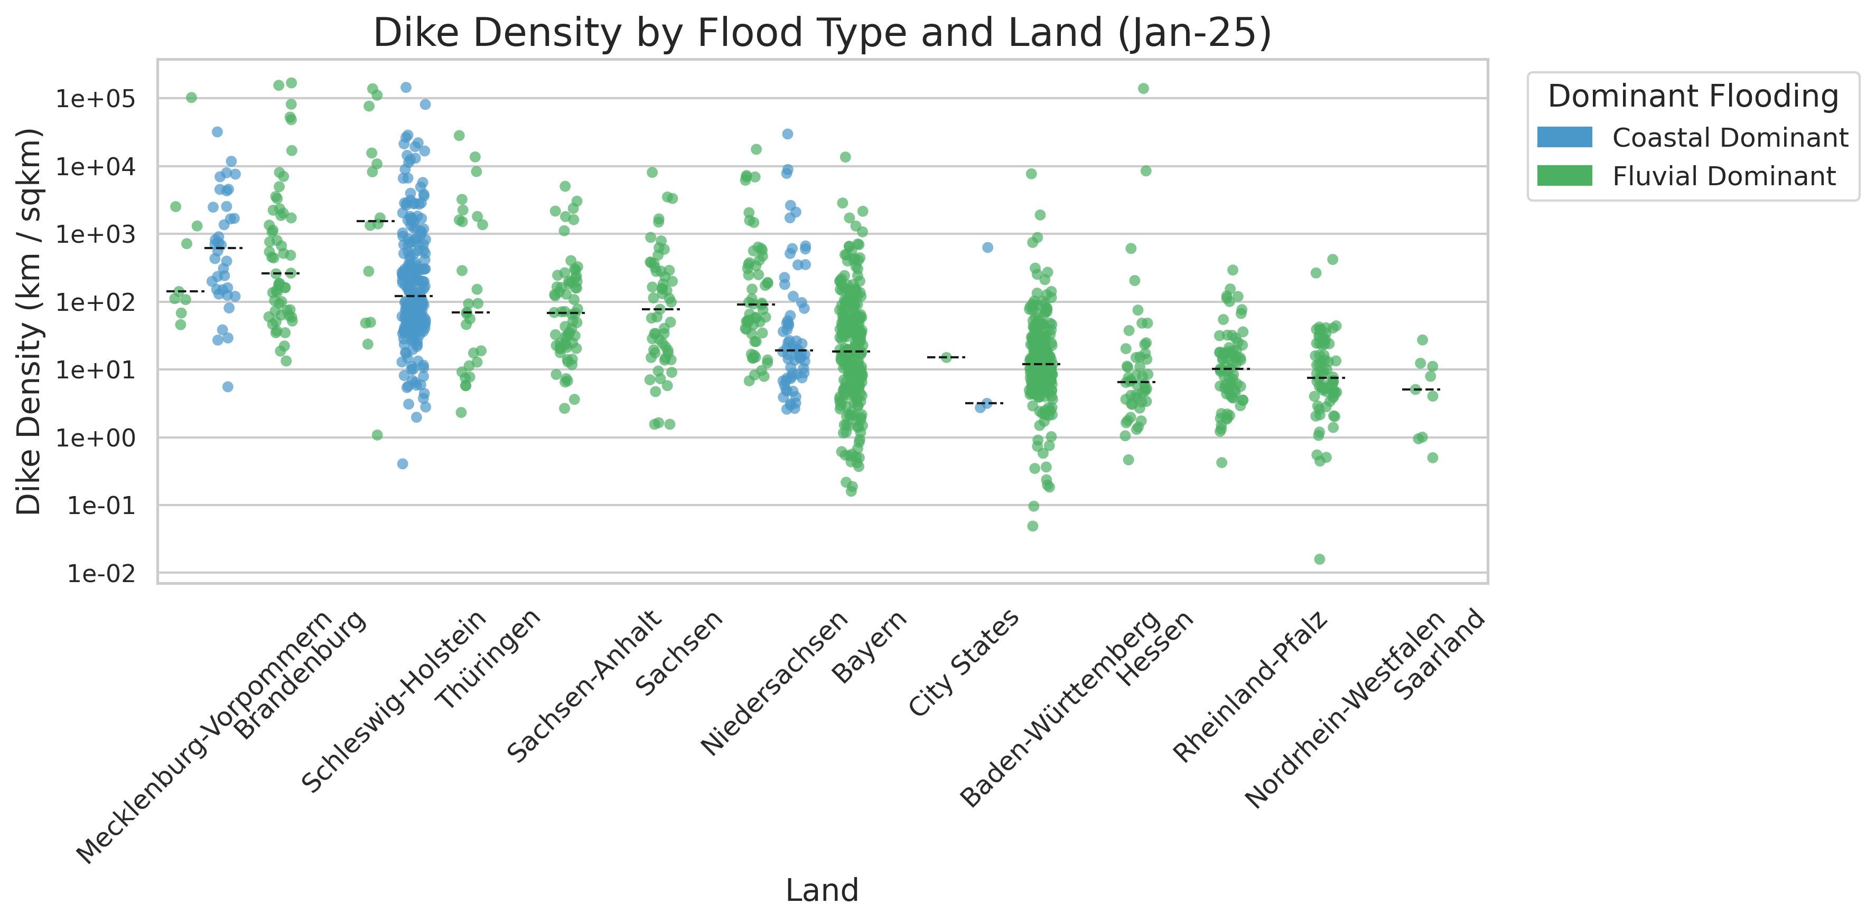
Will test manually adding 75 and 90 percentile line soon

Slide 15
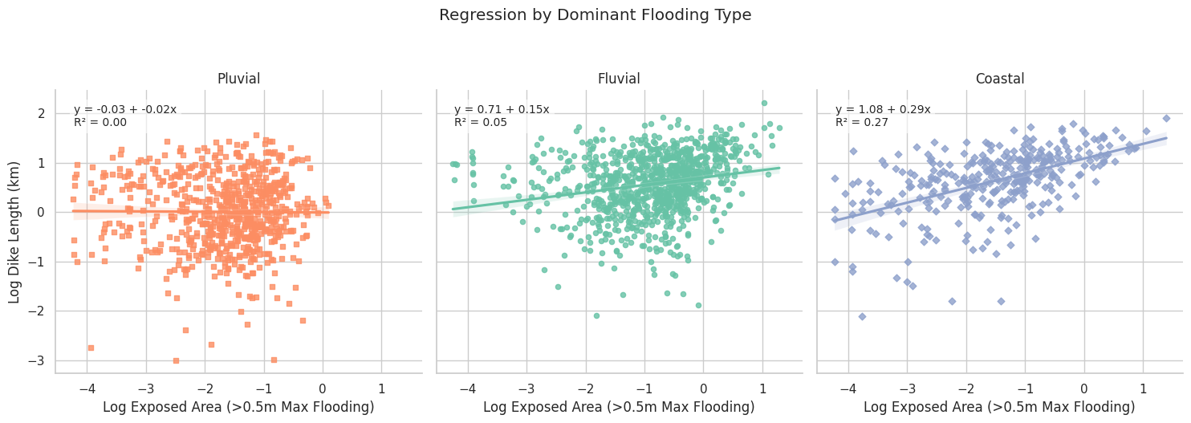

Slide 16
Summary of all Gemeinden included:
Flood Type | Total Exposed Area (sq km)
Coastal (CU) | 152.6109
Fluvial (FU) | 655.7197
Pluvial (PD) | 170.2653

Slide 17
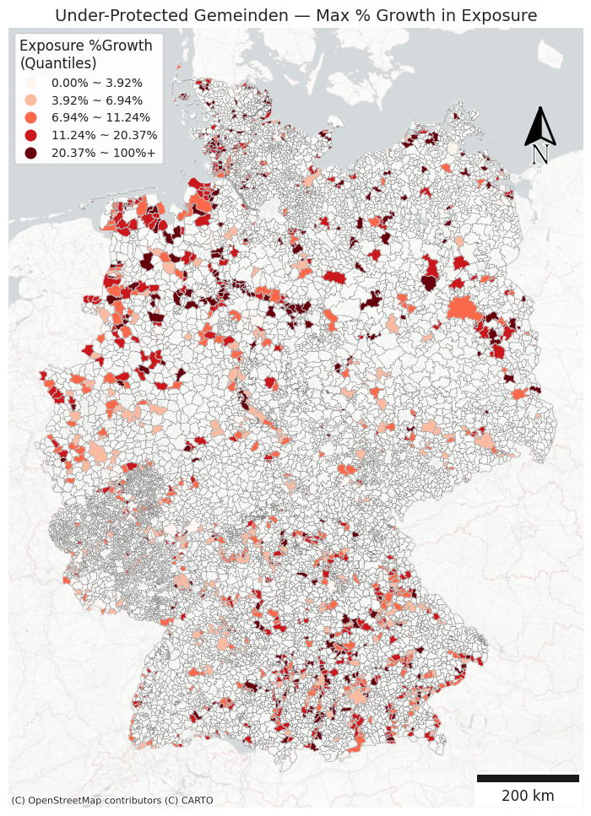
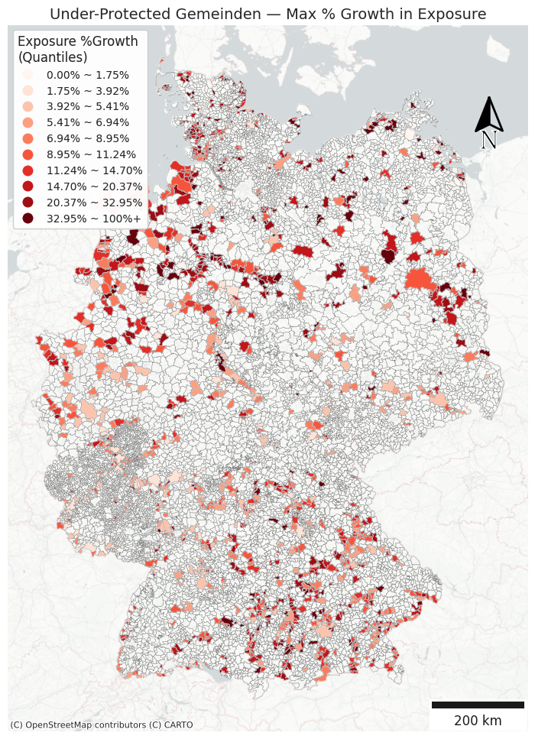
Are we going to use the 5 quantile breaks or customized breaks?
10 quantile breaks may be too many?

Slide 18
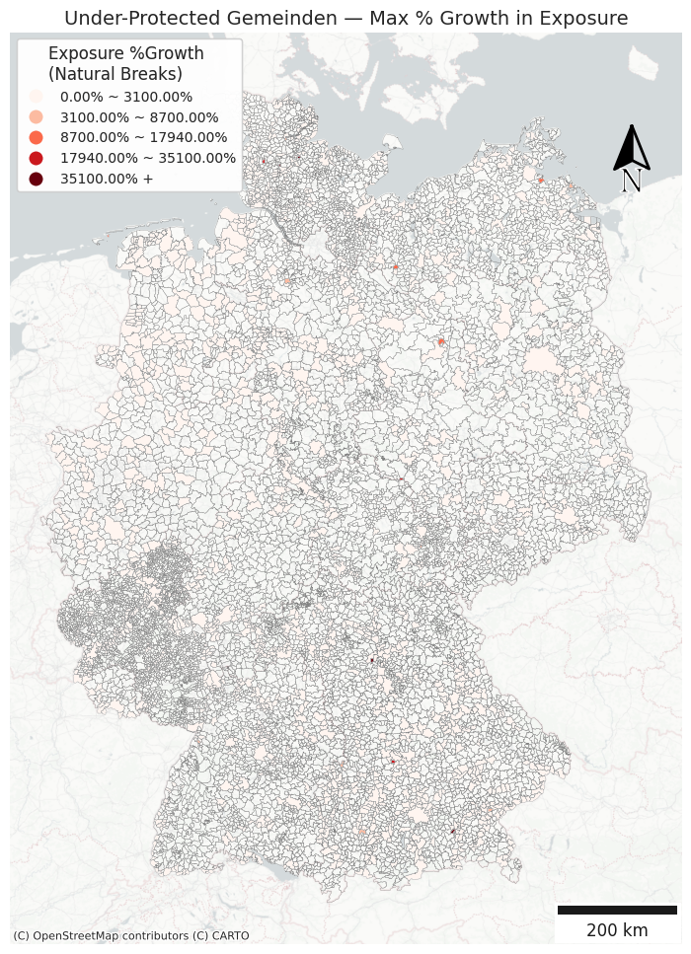
Natural Breaks doesn’t work well for this map…

Slide 19
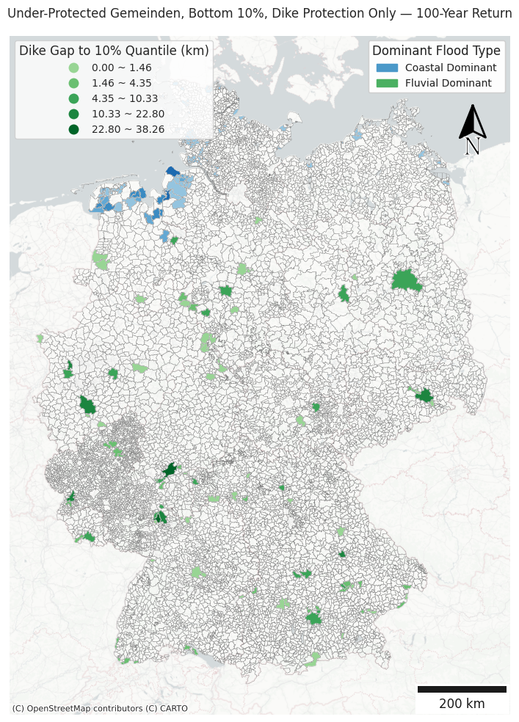
Sum of Dike Length needed = 557.58 km

Slide 20
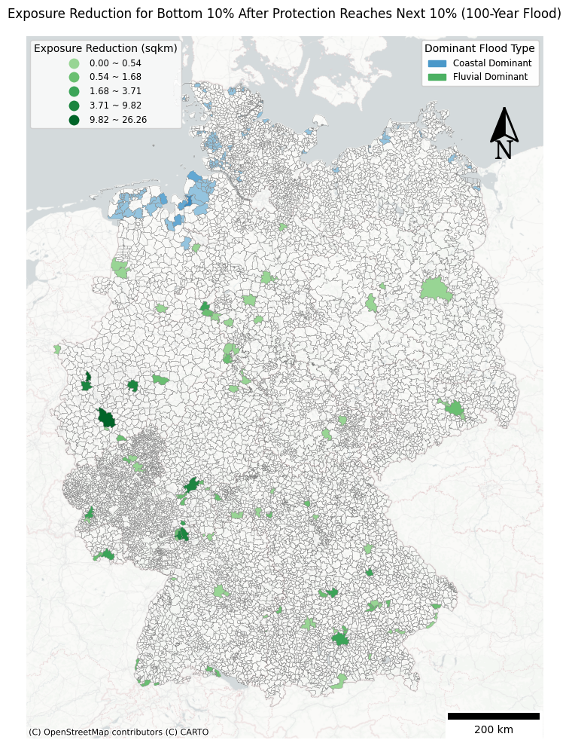
Sum of expected reduced exposure = 159.08 sqkm

Slide 21
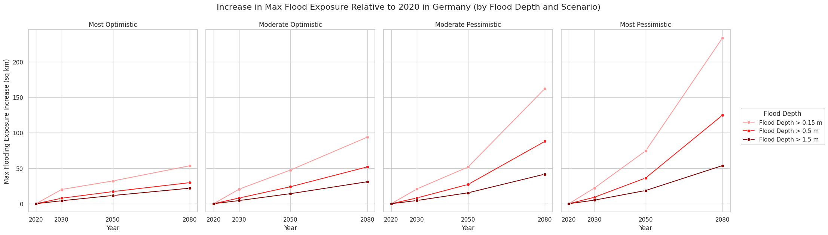

Slide 22
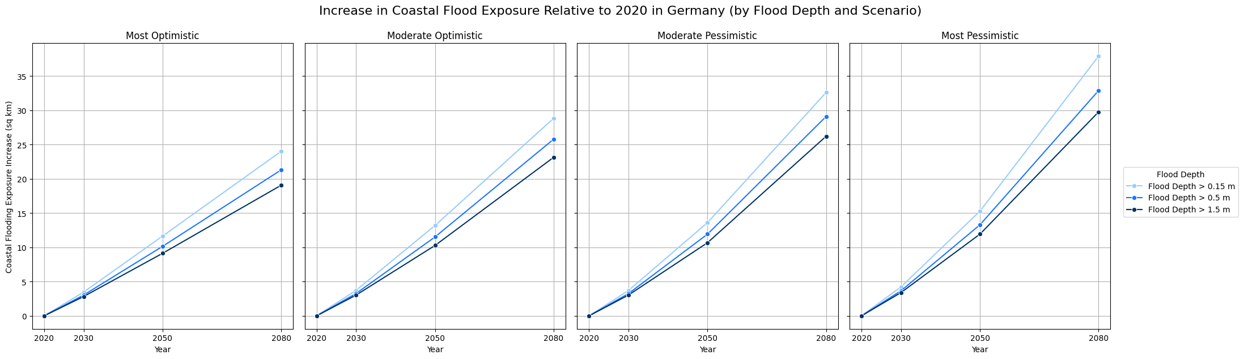

Slide 23
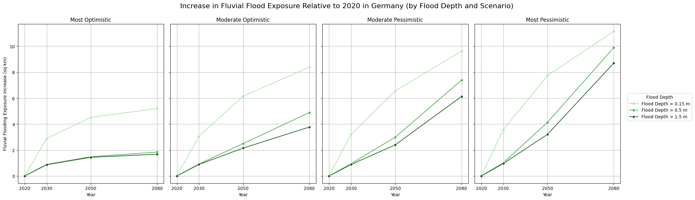

Slide 24
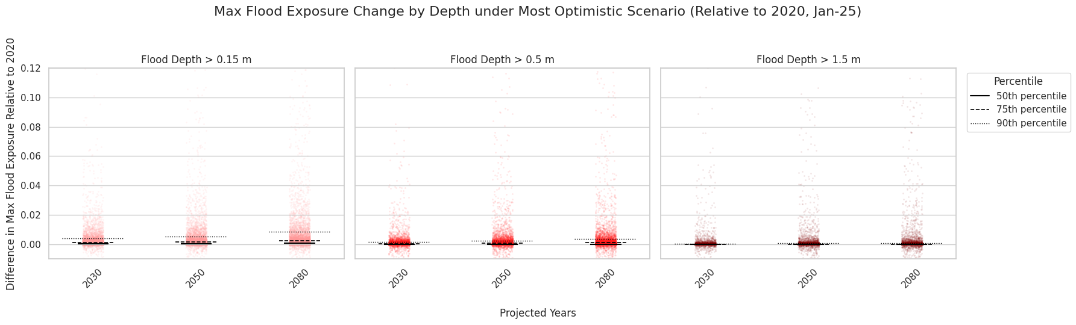
Quantile (>0.15 m) | 2030 | 2050 | 2080
5% | 0.0000 | 0.0000 | 0.0000
10% | 0.0000 | 0.0000 | 0.0000
25% | 0.0000 | 0.0000 | 0.0000
50% | 0.0001 | 0.0002 | 0.0005
75% | 0.0011 | 0.0015 | 0.0024
90% | 0.0040 | 0.0053 | 0.0082
95% | 0.0080 | 0.0110 | 0.0165
99% | 0.0249 | 0.0417 | 0.0778

Slide 25
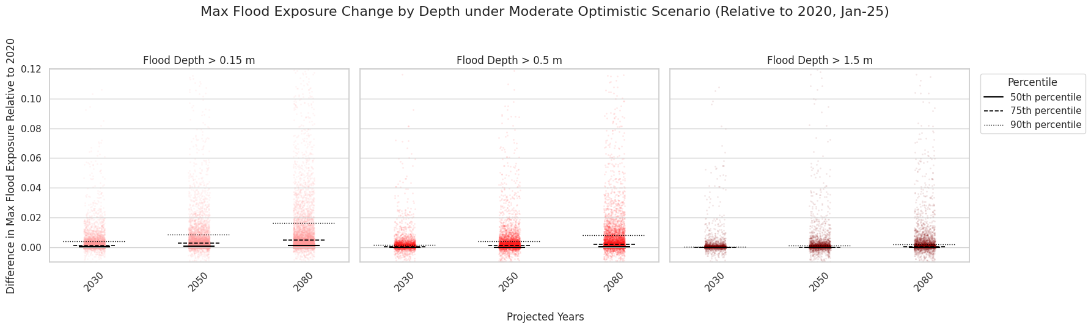
Quantile (> 0.15 m) | 2030 | 2050 | 2080
5% | 0.0000 | 0.0000 | 0.0000
10% | 0.0000 | 0.0000 | 0.0000
25% | 0.0000 | 0.0000 | 0.0000
50% | 0.0001 | 0.0005 | 0.0010
75% | 0.0011 | 0.0025 | 0.0047
90% | 0.0041 | 0.0084 | 0.0163
95% | 0.0082 | 0.0163 | 0.0337
99% | 0.0254 | 0.0645 | 0.1285

Slide 26
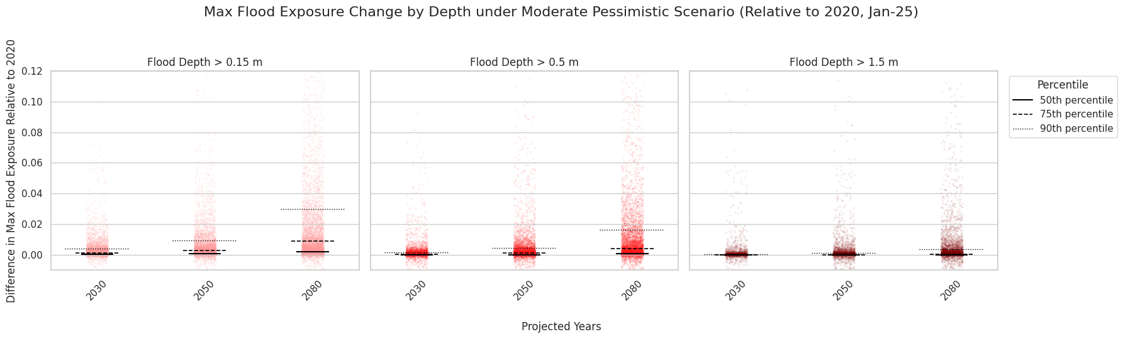
Quantile (> 0.15 m ) | 2030 | 2050 | 2080
5% | 0.0000 | 0.0000 | 0.0000
10% | 0.0000 | 0.0000 | 0.0000
25% | 0.0000 | 0.0000 | 0.0001
50% | 0.0001 | 0.0005 | 0.0018
75% | 0.0011 | 0.0027 | 0.0088
90% | 0.0041 | 0.0093 | 0.0300
95% | 0.0082 | 0.0183 | 0.0620
99% | 0.0255 | 0.0690 | 0.2229

Slide 27
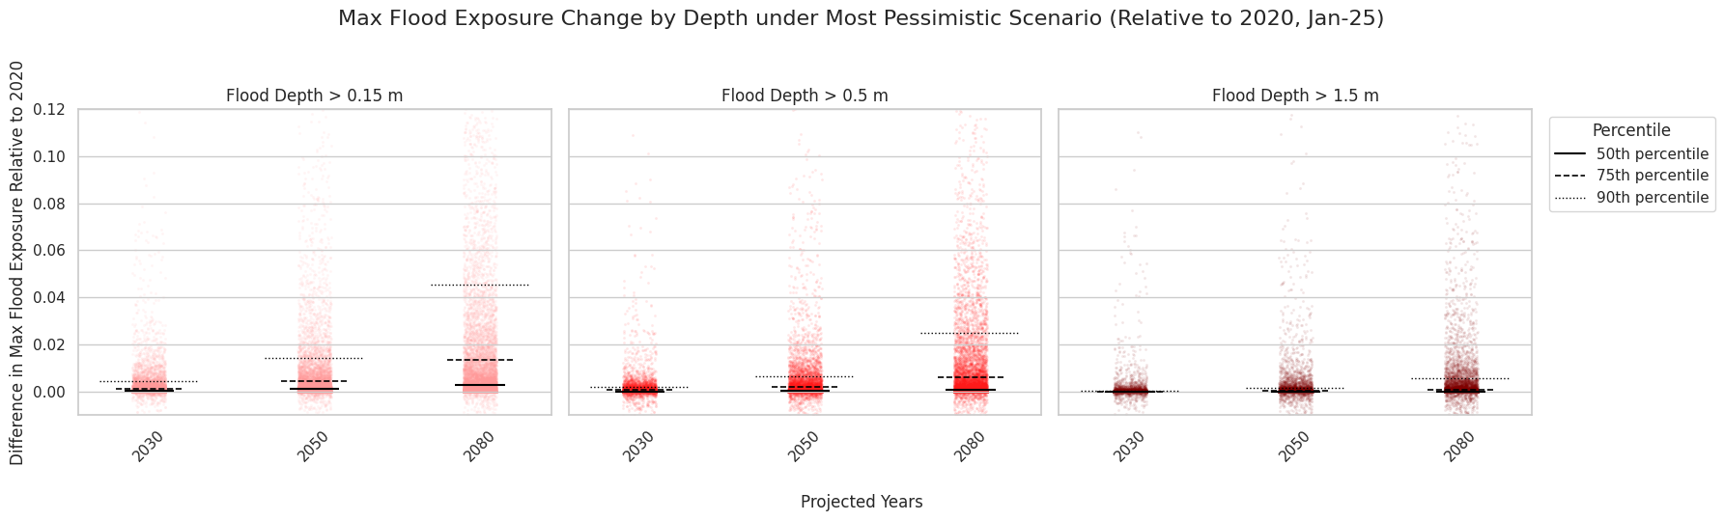
Quantile (> 0.15m) | 2030 | 2050 | 2080
5% | 0.0000 | 0.0000 | 0.0000
10% | 0.0000 | 0.0000 | 0.0000
25% | 0.0000 | 0.0000 | 0.0002
50% | 0.0001 | 0.0009 | 0.0028
75% | 0.0012 | 0.0042 | 0.0135
90% | 0.0043 | 0.0142 | 0.0454
95% | 0.0085 | 0.0280 | 0.0917
99% | 0.0277 | 0.0975 | 0.3131

